Slide 1
Adaptive Cruise Control 自适应巡航

Slide 2
CONTENT
1
Overview（综述）
ACC Concept (ACC概念)
ACC Use Case (ACC用例)
ACC Limitation (ACC约束）
ACC architecture (ACC架构)
2
Target Select（目标选择）
Concept: Funnel (漏斗概念）
In Path (处于路径中)
Cut In (车辆切入)
Cut Out (车辆切出)
3
Control Logic （控制逻辑）
Arbitration (仲裁)
State Machine (状态机)

Slide 3
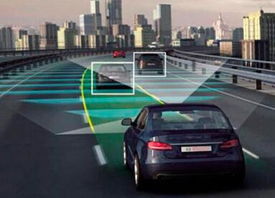
1
Overview（综述）
Part
ACC Concept (ACC概念)
ACC is a comfort system using external looking sensors to detect and measure the range and the relative speed to the lead vehicle. ACC controls the engine and, when necessary, the brakes to adjust the vehicle speed to follow the vehicle driving in front of the ACC Vehicle.
ACC是一套面向舒适性的系统，它通过使用外部传感器来检测前方车辆距离及相对速度，并在需要时通过控制引擎和刹车来调整速度以实现稳定跟随前车。

Slide 4
1
Overview（综述）
Part
ACC Versions （ACC的版本）
功能描述：
The ACC functionality for speed range 0-150 km/h
启停型ACC可以将速度作用范围拓展到0-150km/h。
Stop&Go will reduce the vehicle speed down to standstill if necessary.
停走功能可以控制降低车速直到静止。
Reactivation from stop can be carried out automatically if lead vehicle takes off within a time frame of 3 seconds after host vehicle became stationary.
如果在跟停后3s内前车起步，自车可以自动从静止状态跟随前车起步。
Reactivation from stop longer than 3 seconds requires a driver action.
跟停超过3s后前车起步，需要驾驶员动作来重新激活ACC。

Slide 5
1
Overview（综述）
Part
ACC Top Use Case (ACC顶层用例)

Slide 6
1
Overview（综述）
Part
ACC Limitation
The System does not react on pedestrians, animals, or other non-vehicle objects.
系统对行人、动物和其他非车辆目标不响应。
The System is only reacting on vehicles that are moving in the same direction.
系统只对同向行驶车辆做出响应。
Within the speed range 0-60km/h the system is additionally reacting on stationary objects .
在0-60km/h的速度域内，系统会对静止目标做出反应。
If the ACC vehicle has been standing still for more than 3 seconds, the driver needs to press the accelerator pedal or the resume button to reactivate.
如果ACC车辆已经停车超过3s，需要驾驶员踩油门踏板或使用恢复按钮重新激活功能。
ACC will hold the vehicle stationary for up to 3 minutes on the service brakes. After that, ACC is cancelled and the electric parking brake is activated.
ACC 使用行车制动将车辆保持静止最多3分钟，随后ACC会退出并且电子手刹会被激活。
ACC is a comfort system, it will only adapt the speed in a soft way and it has limited braking authority.
ACC 是舒适性系统，它只能以舒缓的方式控制速度，并且它的刹车能力有限
The driver always needs to be prepared to intervene whenever he sees that ACC is not keeping the right speed or distance.
当驾驶员发现ACC系统没有控制在正确的速度和距离时，应做好接管准备。

Slide 7
1
Overview（综述）
Part
Architecture

Slide 8
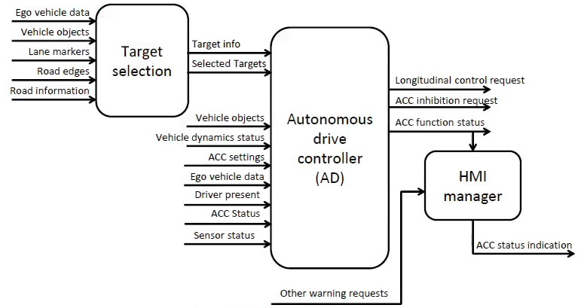
1
Overview（综述）
Part

Slide 9
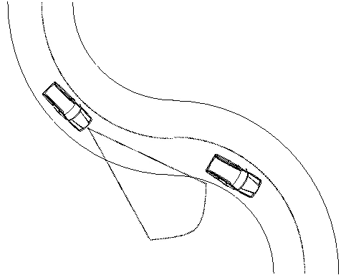
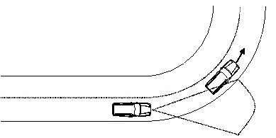
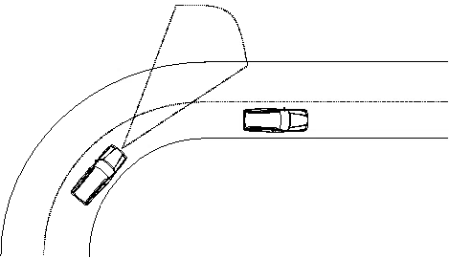
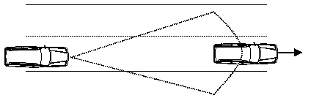
2
Target Select（目标选择）
Part
Following Lead Vehicle （跟随前车）
S-Curve
ACC Shall not drop a selected target in following scenarios.
Curve Exit
Straight Road
Curve Entry

Slide 10
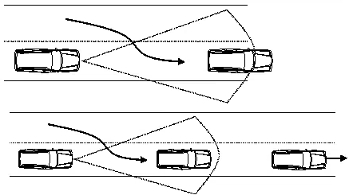
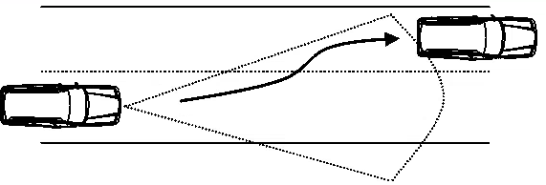
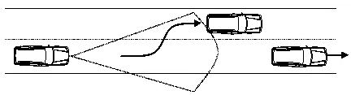
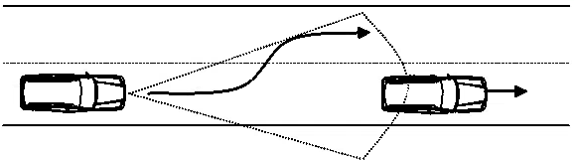
2
Target Select（目标选择）
Part
Cut In & Cut Out (切入&切出）
Lead vehicle cut-in 前车切入
Ego vehicle lane change to a target
自车变道至目标车后
Lead vehicle cut-out 前车切出
Ego vehicle lane change to no target
自车变道至空闲车道

Slide 11
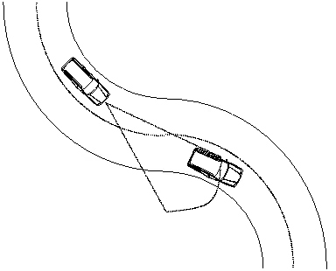
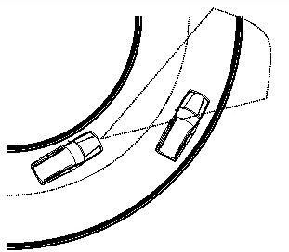
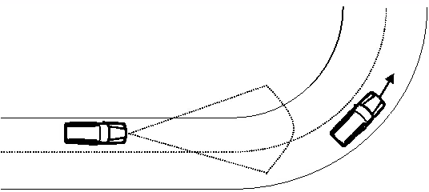
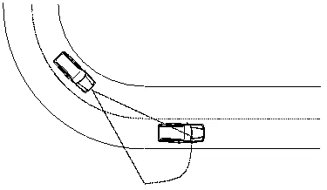
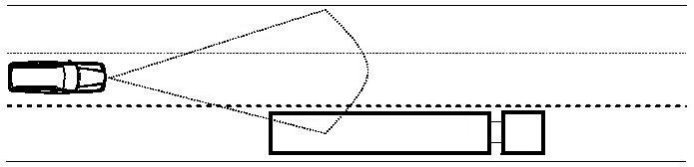
2
Target Select（目标选择）
Part
Passing adjacent lane vehicle
超过相邻车道车

Slide 12
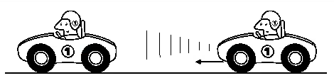
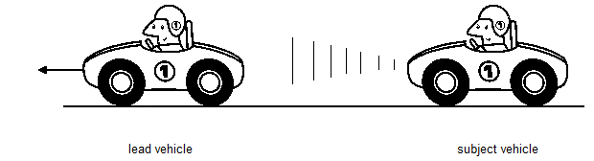
2
Target Select（目标选择）
Part
Stop & Go
If lead vehicle stops, Stop & Go bring the ACC vehicle to a complete stop about 3-4 meters behind the lead vehicle.
如果前车刹停，ACC启停功能会将自车刹停至距离前车大概3-4米远的位置。
The ACC controller brake down to a very low speed behind lead vehicle and then creeps forward very slowly for 1-3 seconds before stopping.
ACC控制器会先制动到一个很低的速度然后在前车后缓慢爬行1-3秒后再刹停。

Slide 13
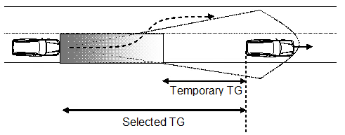
2
Target Select（目标选择）
Part
Overtaking 超车辅助
Narrowing the Time Gap in order to give an acceleration within the acceleration zone(grey zone).
在灰色区域内临时缩小Time Gap以提供加速。
The acceleration rate of change should be increased to enable faster response.
适当放宽加速度的变化率以加快响应速度。
Fall back to selected Time Gap shortly after the “Temporary Time Gap” is reached, if host vehicle is still behind the present lead vehicle.
如果达到临时Time Gap后一段时间后自车仍处于目标车后面，退回到用户选中的Time Gap位置。

Slide 14
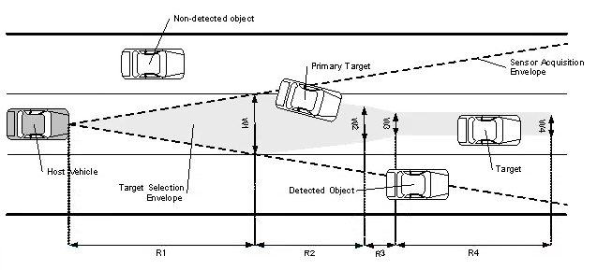
2
Target Select（目标选择）
Part
Concept: Funnel （漏斗）
The Path funnel shall be the width around the center of the predicted path curve of the host vehicle. In other words, the center of the funnel shall bend according to the predicted path direction.
路径漏斗应该是围绕着自车预测轨迹的一片区域。换言之，漏斗的中心应该根据预测的轨迹方向相应的弯曲。

Slide 15
2
Target Select（目标选择）
Part
Concept: Funnel （漏斗）
Normal Funnel & Wider Funnel（普通&略宽漏斗）
Normal Funnel is used to select closest in path vehicle(A) and the second closest in path(B).
普通的漏斗用于选择路径中最近的目标车辆A和次近的车辆B。
Wider Funnel is used to select the closest in path to the left(C) and the closest in path to the right(D)
更宽的漏斗用于选择路径左侧最近的目标车辆C和路径右侧最近的目标D。
Inner & Outer（内部&外部漏斗）
There shall be two envelopes for every ACC funnel:
One for targets entering(inner funnel)
And one for targets leaving((outer funnel)
Influence Factor（影响因素）
Predicted ego path （预测自车轨迹）
Object longitudinal position（目标纵向距离）
Lane width（车道宽度）
Turn Indicator（转向灯信号）

Slide 16
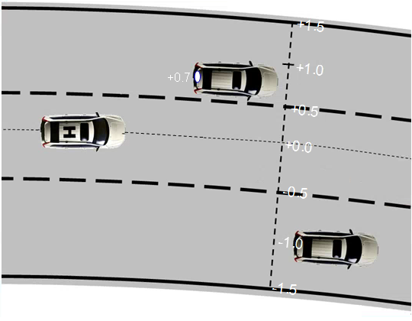
2
Target Select（目标选择）
Part
Pre Calculation（预计算）
The Host Path Offset（路径偏移）
It shall be based on the lateral distance between the target and the vehicle
该值为目标的横向位置与自车轨迹的偏移量
OffsetDeriv
Filtered Derivative of the host path offset
滤波后的路径偏移速率
Predicted Offset
PredictedOffset = Offset + OffsetDeriv * Calibration.PredictionTime(Different on scenario)
预测时间后的路径偏移（不同的场景采取不同的预测时间标定量）

Slide 17
2
Target Select（目标选择）
Part
Logic to determine an object as in path（判断目标处于自车路径的判断逻辑）
Out of path become in path: （路径以外目标进入路径中）
Object is mature and not coasted, its filtered path offset should be inside of the inner funnel.
目标必须是稳定的且不是经过递推的目标，滤波后的路径偏移应该落在内部漏斗区域内
Remain in path（留在路径中的条件）
Even if it is coasted, as long as offset is inside of the outer path funnel.
即使目标是递推后的目标，只要路径偏移仍在外部漏斗内，仍算作在路径中。
Out of path （离开路径条件）
Object’s filtered path offset become outside of the outer path funnel.
目标滤波后的路径偏移超出了外部漏斗的区域范围。

Slide 18
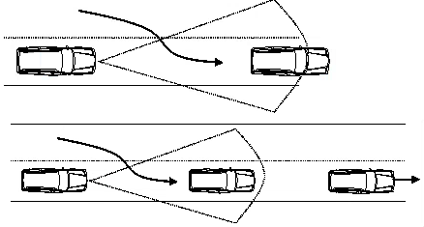
2
Target Select（目标选择）
Part
Concept: Cut In （切入）
The new target shall be selected as A or Cut in target when 30% of lead vehicle has passed the lane marking if lane markings are visible and in good condition and the subject vehicle is driving centered in subject lane.
在自车行驶在车道中心而且车道线清晰可见的情况下，当前车30%跨过车道线时应该被选为主目标A或者切入目标。

Slide 19
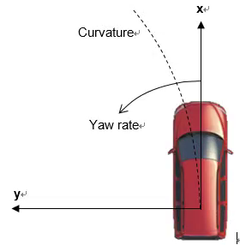
2
Target Select（目标选择）
Part
Concept: Cut In （切入）
Cut In Precondition
Object Longitudinal Distance : 5m ~ 100m （目标纵向距离）
Minimum Object Speed: 2.5 m/s （目标最小速度）
Object Type shall not be Unknown （目标类型不能是未知）
Object shall be fusional（目标必须是Fusion后的结果）
Cut In Logic
Offset shall be in Wider funnel(has been selected as C or D) （目标要首先被选为C或D）
Sign(Offset) != Sign(OffsetDeriv)（路径偏移的符号和偏移速度的符号相反，即向中心靠近）
PredictedCutInOffset shall be in Inner funnel（预测时间后路径偏移要在内部漏斗范围内）
Longitudinal distance shall be closer than target A（目标纵向距离要小于主控制目标A）

Slide 20
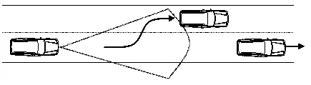
2
Target Select（目标选择）
Part
Concept: Cut Out（切出）
The lead vehicle shall be deselected as “cut out vehicle” latest when 25% of lead vehicle is in the adjacent lane if lane markings are visible.
车道线可见情况下，前车最晚要在25%已经在相邻车道时被置为切出车辆。

Slide 21
2
Target Select（目标选择）
Part
Concept: Cut Out（切出）
Cut Out Precondition(Same as cut in)
Object Longitudinal Distance : 5m ~ 100m （目标纵向距离）
Minimum Object Speed: 2.5 m/s （目标最小速度）
Object Type shall not be Unknown （目标类型不能是未知）
Object shall be fusional（目标必须是Fusion后的结果）
Cut Out Logic
Offset shall be in Normal funnel(has been selected as A) （只有主控目标A才判断切出）
Sign(Offset) == Sign(OffsetDeriv) （远离中心）
Object Time Gap < Threshold 2s (Not too far)（目标实时车间时距小于2s）
PredictedCutOutOffset shall be out of Outer funnel （预测时间后的路径偏移超出外部漏斗）

Slide 22
2
Target Select（目标选择）
Part
Architecture

Slide 23
3
Control Logic （控制逻辑）
Part
Acceleration & Arbitration (加速度与仲裁)
D_ref = TimeGap * V_lead (跟车参考距离 = 用户设置时距 * 前车车速)
默认TimeGap五档对应时距为[ 1 1.25 1.6 2 2.6] 秒

